Slide 1
The ethical imperatives for post-normal science; lessons from a wastewater outfall
Scott Bremer
ASFPG Workshop
Hamburg
12-14 October 2011

Slide 2
Environmental governance in response to ‘wicked problems’
Environmental governance; ‘interventions aiming at changes in environment-related incentives, knowledge, institutions, decision-making and behaviours’ (Lemos and Agrawal, 2006)
More simply…society’s collective response to environmental issues
These issues are increasingly described as ‘wicked-’ ‘meta-’ or ‘unstructured-’ problems, characterised by:
Complexity and significant uncertainty
Plurality of legitimate perspectives
High political stakes

Slide 3
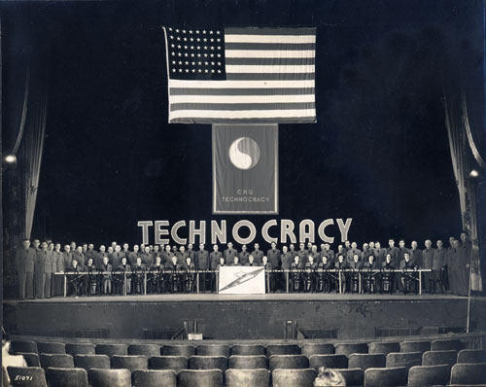
These issues challenge the legitimacy of technocratic and scientifically-rational decision-making processes alone.

Slide 4
Democratising society’s collective decision-making
‘Participatory democracy’
Governance theory
Participatory planning
Co-management and adaptive co-management
Collaborative learning
Social network theory
Ecological economics
Mode 2, transdisciplinarity, post-normal science…

Slide 5
Four common imperatives
Normative
Substantive
Instrumental
Social learning
These imperatives can be discussed as ethical arguments for democratising decision-making

Slide 6
A focus on the ‘post-normal science’ perspective on mobilising knowledge in support of collective decision-making

Slide 7
Post-normal science
Focussed on the science-policy interface
Complex social-ecological systems perspective
Epistemological uncertainty recognised as inevitable and irreducible
Dialogic setting
Participatory setting
Reciprocity and co-existence
Focus on quality rather than truth
Extended peer review
Reflexive
Social learning
Adaptive cyclic process
Long-term perspective

Slide 8
Ethical arguments for post-normal science
Substantive: we ought to make decisions based on the best quality knowledge possible.
“Quality…becomes the organising principle of post-normal science because the old ideal of scientific truth is no longer attainable or relevant for policy” (Funtowicz and Ravetz, 1994)
Normative: empowering previously marginalised stakeholders and their knowledge systems as ‘co-investigators’ in an ‘extended peer community’
‘Truth’ informs decision-making behind a closed door…by bringing the uncertainty and quality to the fore, this leaves the door open to new scientific norms of evidence and discourse

Slide 9
Ethical arguments for post-normal science
Instrumental: a ‘social contract’ for science, which is salient, credible and legitimate for decision-making, with an emphasis on procedural rationality
Knowledge is appraised subject to multiple lists of indicators, drawing on rational criticism, practical criticism, and ethical criticism (Clark and Majone, 1985)
Social learning: learning can be discussed as a ‘good;’
Stakeholders each contribute their unique perspective on our shared ‘social reality’ (O’Connor, 1999), while learning competence at the interface between politics, science and decision-making (Van de Kerkof, 2006)

Slide 10
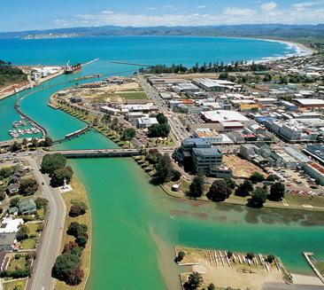
Case Study:
The Gisborne Wastewater Outfall

Slide 11
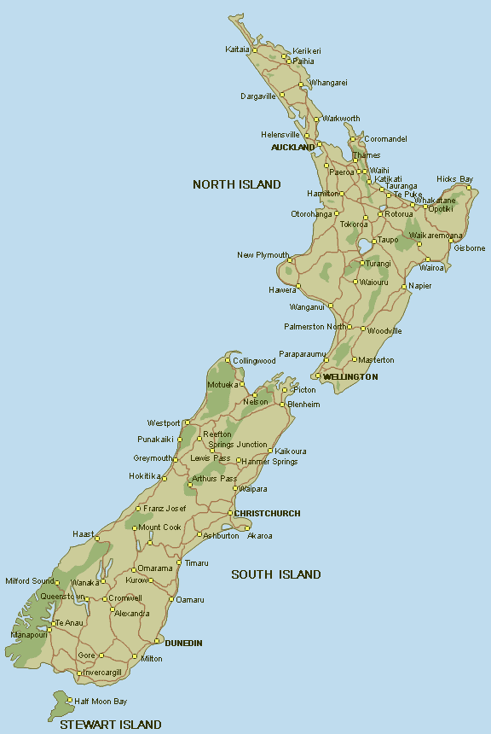
Gisborne and Poverty Bay

Slide 12
Gisborne
Relatively isolated on the rugged East Cape
Pop. 34,000; 42% Maori (compared to 14.5% nationally), with almost half Maori bilingual
Popular holiday location with three surf-beaches and high sunshine hours
Serving a hinterland characterised by horticulture and viticulture
Not a wealthy city; lower income than national avg.
Governed by the Gisborne District Council (GDC) ‘unitary authority’

Slide 13
The Gisborne wastewater outfall
1964 – Commissioned
1991 milliscreens installed
1993 and 1999 GDC applied for ‘resource consent.’ Strong opposition by Maori, Environmentalists and Recreation groups; appealed to the Environment Court.
2005 new resource consent application. Convened the ‘Wastewater Adjournment Review Group’ (WARG) to co-investigate upgrading treatment via ‘Biological Trickling Filter’
2007 Decision reached to build BTF plant, with UV treatment to be added in 2012; Wastewater Management Committee
2009 Decision modified via consultation with the WARG (now called the Wastewater Options Review Group or WORG)

Slide 14
The WARG
The WARG incorporated stakeholders from GDC, the local Department of Conservation office (DOC), the District Health Board, tangata whenua as represented by Te Runanga o Turanganui a Kiwa (TROTAK), and Oho Ake a local environmental NGO.
Met once per week, with the independent facilitation of a local lawyer
Clear objectives, and well-defined collaboration, membership, and protocols.
Detailed minutes kept and communicated to other stakeholders and the community via the media
Supported deliberation by bringing in scientific and technical expertise, including a resource planning consultant to guide process
Took fieldtrips to other BTF plants
Led by GDC resources, but most stakeholders contributed in kind.

Slide 15
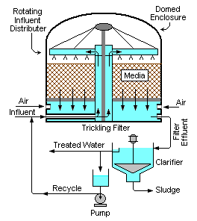
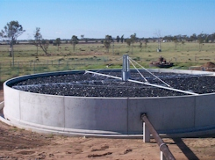
Biological Trickling Filter

Slide 16
Substantive outcomes
Rejection of GDC’s science-centric, linear view of the environment as a sink; “in-process-out sort of stuff”
Appreciation for a more holistic, systemic perspective on the environment through biotransformation.
“…you take man and you take his waste, the whole idea inherent in a lot of it is to put as many biological cycles in between…one of our problems here is that we’re short-circuiting it by putting it in the bay.”
Uncertainties identified as epistemological:
“If I’ve got a whole lot of facts, and you’ve got a whole lot of different ones, we haven’t compared them and we’re acting from them, then we’re not going to agree on a higher level.”

Slide 17
Normative outcomes
Involving marginalised groups in collective decisions
“It sort of symbolised to many Maori around here Pakeha insensitivity, colonisation, arrogance, domination, exploitation.”
Knowledge supported consensus; negotiating evidence rather than political trade-offs
“…knowledge has become shared. And so people have actually said to the owners of the knowledge, ‘what does it mean?’ So knowledge has become more jointly owned.”
Reciprocity extended to other knowledge systems
“a primary assumption on the part of people…that nobody had a complete monopoly over what was right… there was an implicit recognition that everybody contributes something to the group.”

Slide 18
Instrumental outcomes
Co-existence of parallel criteria for decision-making; scientific risk and CBA vs Maori spiritual measures;
“it isn’t on a scale of zero to one hundred…it’s a yes or no phenomenon; there isn’t an acceptably unhealthy environment.”
Reciprocity from critically questioning perspectives, including ones own
“…a recognition that everybody contributes something to the group, but there wasn’t a right of rubbish.”
The WARG operated according to a consensus model; tabling a piece of evidence and debating its quality:
“The fact that we had a group that was talking though it is what got us there. We didn’t at the end of the day have time to (scientifically) peer review our information, but I think we almost had a peer review amongst all the parties, because we had such a wide range of views.”

Slide 19
Social learning outcomes
Recognised that all participants were ‘laymen’ relative to the complexity of the issue, with no one having knowledge of all dimensions and facets;
“A group of laypeople with skills in limited areas… the knowledge of particular areas was limited to particular people.”
Traditional, scientific and local knowledge
Mutual learning; Maori adopted the science, while the GDC accepted that all that is relevant is not measurable; particularly through biotransformation.
Increased learning corresponding closely to increased trust, tolerance, and respect for other perspectives

Slide 20
Social learning outcomes
As stakeholders felt ‘safer’ to share their knowledge learning resulted;
“we began to share understandings because there was a willingness…to listen.”
Biotransformation formed the basis of learning. Maori introduced a metaphysical notion biophysical change, though also learned about the science:
“the science that they provided us told us that there was a change of state somewhere”
Meanwhile GDC reflexively admitted that;
“the truth or the reality of things is not just scientific or measurable.”
Questioned representative in favour of participatory democracy

Slide 21
WARG self-appraisal
Mobilisation of knowledge was well integrated with, and facilitated, decisions:
“Clearly our decisions were based on those shared knowledges.”
“…if it hadn’t been for the knowledge sharing you wouldn’t have got the decision.”
Similarly it had socio-political outcomes
“People have listened and seen the benefit of listening. So you’ve seen the council change over time because they’ve seen this as a way of avoiding conflict in the environment court…people have bought in to that process and liked it; it has created a social capital that wasn’t here before.”

Slide 22
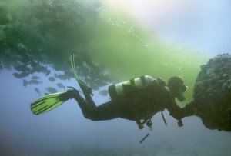
Thank you
Questions/Comments?

