Slide 1
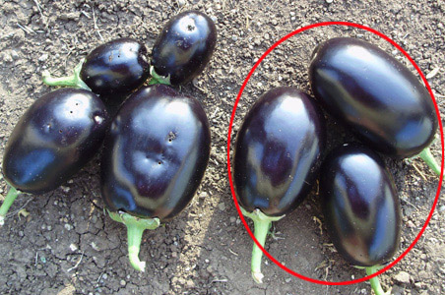
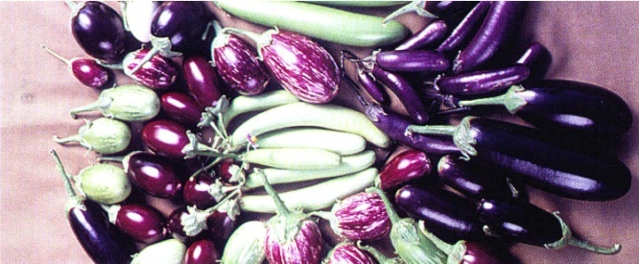
Politics and Ethics of Emerging Technosciences :
Bt Brinjal Controversy in India
Jacob Kalle, PhD Scholar
Centre for knowledge Culture and Innovation Studies (CKCIS),
University of Hyderabad, India

Slide 2
Presentation overview
Introduction – Technoscience
Over view of GM debate
GM in Indian Context
Bt.brinjal controversy- consultations
Ethical Matrix

Slide 3
TECHNOSCIENCE
It is generally argued that humans purposefully design processes and artifacts in order to extend their capabilities to manipulate material and information. This is, in part, due to humans not being able to meet their needs through their unmediated interaction with nature. It has also been suggested that humans are ‘pulled’ by artifacts by a practical necessity. We are never free to choose to use no artifacts (McGinn, 1991)
‘Technoscience is knowledge happening or actionable knowledge, physically manipulative and interventionist. These manipulations and interventions are not designed only to describe nature and but also to modify nature. And increasingly technosciences have been changing both the natural and the social world around us through the mode of creating actionable knowledge and manipulating and intervening employing that knowledge. Seen this way, the distinction between an attempt to describe the world and an attempt to reconfigure the world is becoming blurred. This raises a whole range of important normative issues which need to be squarely faced and addressed’ ( P.K. Basu ,2012)

Slide 4
GM debate
GM debate is intimately connected to interest structures and systems of meaning of various actors- farmers, scientists, industry, state, regulatory bodies, consumers and civil society and its organizations.
Industry is interested in making profits; scientists in advancing knowledge and patenting it.
Farmers are interested in enhancing the productivity and obtaining quality seed.
Governments have to ensure food production and at the same time minimize the risks and ensure safety of technology through regulatory bodies.
The interests of the consumers are health and safety of food, culturally mediated aesthetic considerations such as size of the grain, shape of the grain, colour of the grain, taste, and the meanings they attach to food and the wider environment.
Social acceptability of an innovation is mediated by cultural values. GM technologies have a potential to transform nature on one hand and social structure and culture on the other simultaneously (Haribabu 2004)

Slide 5
GM debate
Hidden et al.(2004) account for the differences in the attitude of Americans versus Europeans towards genetically modified food crops of : (a) lack of exposure to information about GM food among the American consumers compared with the Europeans; and (b) Separation of farms physically and psychologically from the urban centers where most of the population lives. In contrast, in Europe farms are much smaller and situated closer to population centers and often adjacent to , or in the midst of ‘natural areas’
Toke (2004:98) noted that some people argue that Americans see food as fuel and “ as fuel that is best according to its cheapness”. While Europeans see food in terms of quality and cultural identity
In India the questions that are being raised regarding genetically modified food are similar to those raised in the European context. In addition the questions of access to proprietary technology is important given the fact the most of the farmers are small and marginal.

Slide 6
Present scenario
Farmland is decreasing..
Population is increasing.
Production is not increasing—stagnant.
Several problems came out in recent days.–
1) increased temperature
2) salinity
3) drought
4) biotic stresses

Slide 7
Importance of Agriculture in Indian economy
Agriculture is vital to India's economy and the livelihood of its people
Contributing 21% to the country's GDP
accounting for 11 % of total exports,
employing 56.4% of the total workforce
supporting 600 million people directly or indirectly
70% of our farmers are small and marginal ones.
27.5% of the population still lived below the poverty line in 2004-05

Slide 8
Key challenges to Agriculture in india
The present growth of agricultural productivity, at the rate of about 2% per year and 3% growth required for food security.
Out of the net cultivated area of approximately 141 million hectares , about 85 million hectares (60%) falls under the dryland/rain-fed zone.
with dwindling land reserves, scarce water and nitrogen and daunting challenges of climate change.
In addition, crop losses due to insects, pests, diseases and declining soil fertility,
50 MT of food grains in 1950 to 241 MT in 2010-11.
Decrease in food grains production

Slide 9
Advances in Plant Biotechnology
plant biotechnology has made significant strides in past twenty years, encompassing developments in plant molecular biology and genetic engineering.
Variety of traits has been introduced in plant species which include: •
Herbicide resistance
Pest resistance
Viral resistance
Slow-ripening Fungal and bacterial resistance Quality
improvement (protein and oil)
Value addition (Vitamins, micro-and macro-elements)

Slide 10
Green to Gene Revolution in Agriculture
Strategy | Green Revolution | Gene Revolution
Focus | National Self sufficiency in Food | Compete in the Global Markets
Policy Instruments | Small-scale farming for food production | Agriculture as a globally competitive industry
Policy Players | Few - State led Universities | Multiple - Biotech Industry, NGOs etc
Funding | State and International Aid | Private Sector and Public Private Partnership
Locus of Science | Field Based | Lab Based
IPRs | Free exchange | Patents / Commercial Confidentiality

Slide 11
Global Scenario of GM Crops
First commercial GM food crop variety ‘FlavrSavr’ tomato, released in 1994, was engineered for slow-ripening character.
GM food crops along with other GM non-food crops were grown by farmers in 134 million hectares, in 2009 in 25 countries.
14 million farmers, including small and resource-poor
countries growing transgenic crops in more than one million hectare, include USA, Brazil, Argentina, India, Canada, China,Paraguay and South Africa.
Six EU countries also planted 94,750 hectares of Bt. Maize in 2009.
India grows transgenic Bt. Cotton in 8.4 million hectares.
Major transgenic crops include soybean, maize, cotton, and canola;
major engineered traits include insect resistance, herbicide tolerance and virus resistance

Slide 12
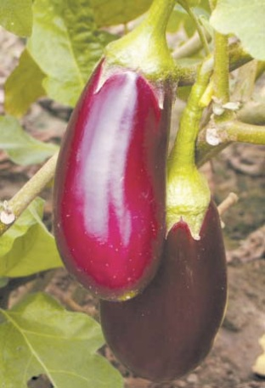
What is Bt Brinjal?
Bt Brinjal is a transgenic brinjal created by inserting a gene cry1Ac from the soil bacterium Bacillus thuringiensis into Brinjal. This is said to give the Brinjal plant resistance against lepidopteran insects like the Brinjal Fruit and Shoot Borer Leucinodes orbonalis and Fruit Borer Helicoverpa armigera

Slide 13
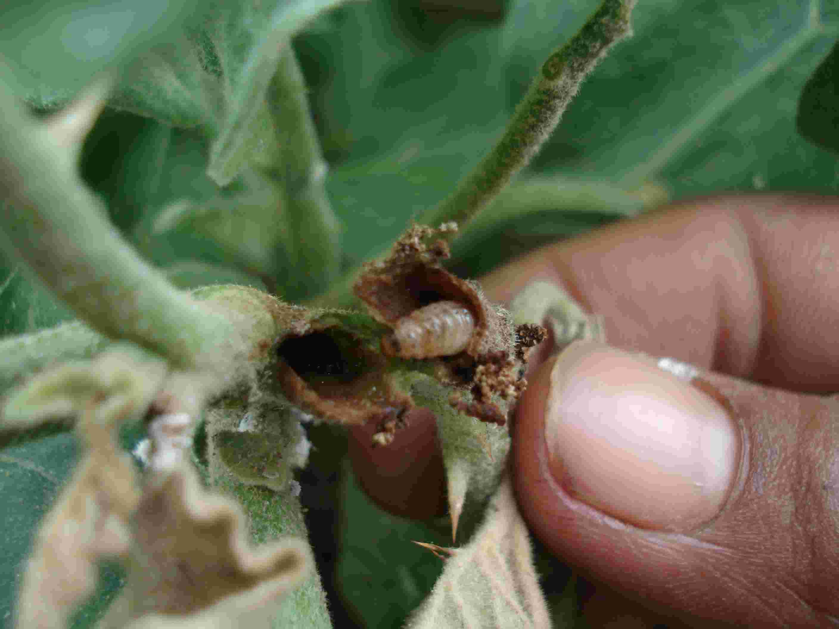
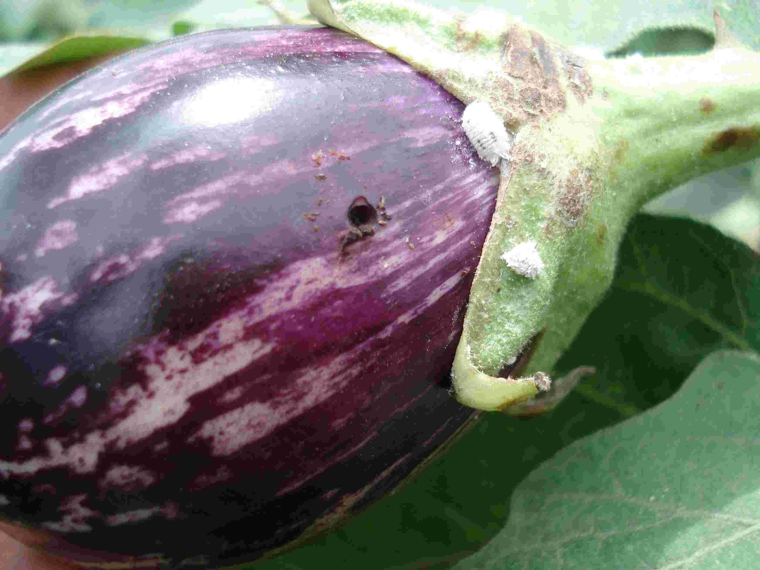
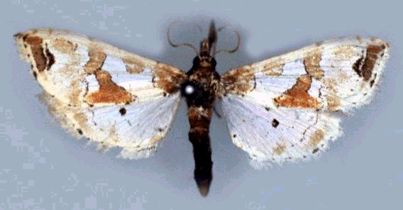
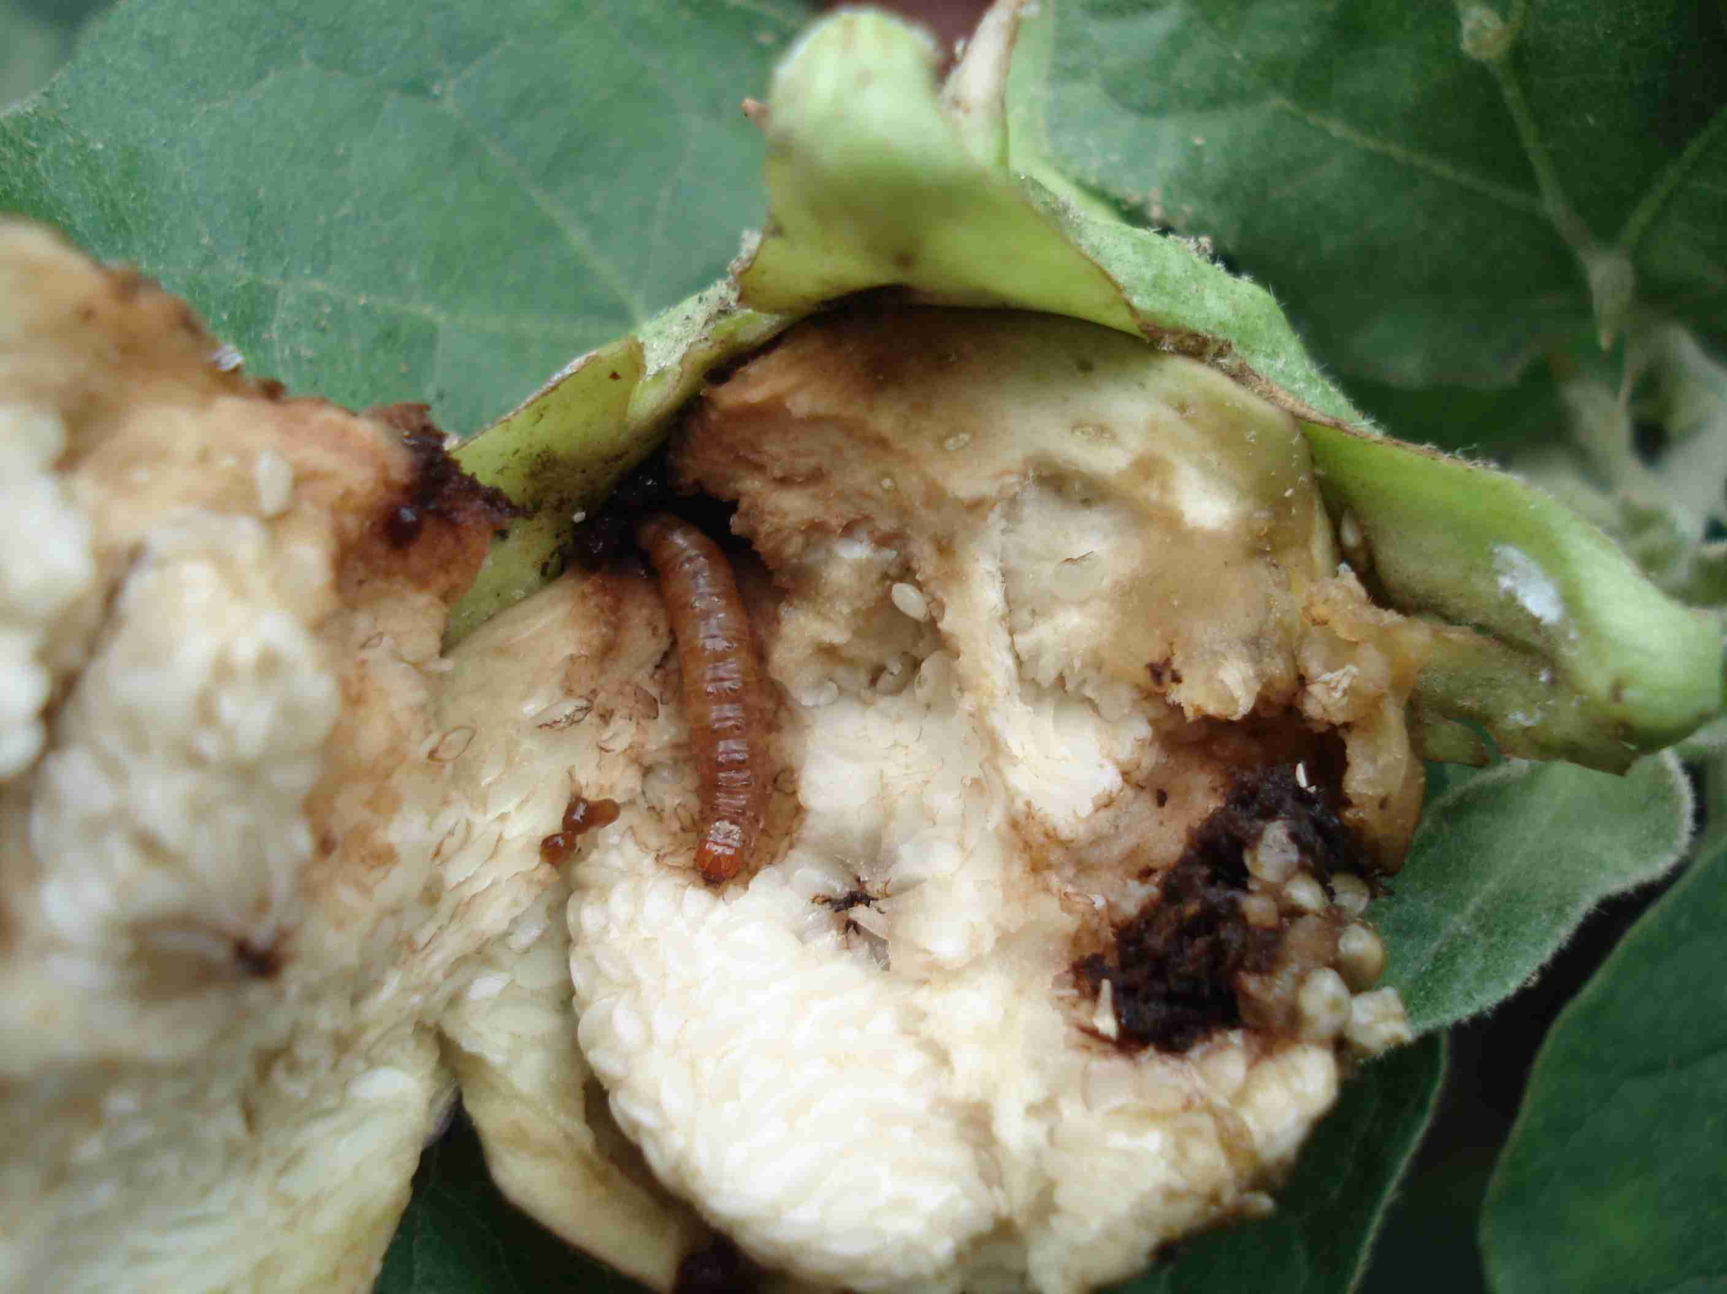
60 - 70% of damage is caused by fruit and shoot borer
Shoot damage Fruit Damage

Slide 14
Development of Bt Brinjal..
Bt brinjal, Event EE1 developed by:
The Maharashtra Hybrid Seeds Company Ltd. (Mahyco), Mumbai, a subsidiary of Monsanto Company, and
The University of Agricultural Sciences (UAS), Dharwad and
The Tamil Nadu Agricultural University (TNAU), Coimbatore

Slide 15
Mahyco’s Presentation ..
Mahyco presented its various test results from 2000 to 2006 on Bt Brinjal on May 26 2006, and concluded that
The target pest is controlled by Bt brinjal.
Biosafety studies conducted till date show no significant differences between Bt and non-Bt brinjal

Slide 16
Regulatory Framework
At Central Level
Genetic Engineering Approval Committee (GEAC) under Ministry of Environment and forests (MoEF) for approval of activities involving large scale use of hazardous microorganisms and recombinants in research and industrial production from the environmental angle including field trials
Review Committee on Genetic Manipulation (RCGM) & Recombinant DNA Advisory Committee (RDAC) under Department of Biotechnology (DBT) Ministry of Science and Technology - with the mandate to monitor safety aspects of ongoing research projects and activities involving such genetically engineered organisms and also to recommend appropriate safety regulations for India.

Slide 17
Regulation..
At State and District Level
Institutional Biosafety Committee (IBSC)
State Biotechnology Coordination Committee (SBCC)
District Level Committee (DLC)
Food Regulatory Authority of India – to monitor and trace the GM foods – Labeling for consumer choice and citizen rights

Slide 18
Scientific Validations
Environment
Health Issues
Technology
Gene transfer to humans / animals and other living systems
Biodiversity
Transformation Systems
Insect Resistance
Antibiotic marker systems
Toxins and Allergens

Slide 19
Socio-economic issues
Food security
Small Farmer Affordability
TNCs Ownership /
IPR issues
Regulatory issues
GM Labeling - Infrastructure
Socioeconomic Issues in Commercialization of
Bt Brinjal

Slide 20
Tests by Expert Committee II
Toxicity
Allergenicity
Out-crossing / Gene flow
Effects on non-target organisms
Environmental impact
Pest resistance

Slide 21
GEAC Recommendations..
Decisions taken in the 97th Meeting of the Genetic Engineering Approval Committee (GEAC) held on October 14.2009.
After detailed deliberations and taking into consideration the findings of the review by three high level technical committees namely the RCGM and two Expert Committees constituted by the GEAC in 2006 and 2009, the GEAC concluded that Bt Brinjal is safe for environmental release. Since this decision of the GEAC will have major policy implications, the GEAC decided to forward the recommendations and report of the Expert Committee on the safety and efficacy of Bt brinjal event EEI to the Government for a final view. It was also agreed that the report of the Expert Committee would be made available in the public domain by posting on the MoEF website at the earliest

Slide 22
Public Consultations..
October 15, Press Statement by Jairam Ramesh, Minister of Environment and Forests,(MoEF) to start public consultations with other stakeholders

Slide 23
Public Hearings - Organised by Centre for Environmental Education (CEE) Ahmadabad
Kolkatta (13.1.2010 - 1100-1400 hrs Venue: Lecture Hall, Bose Institute,Main Campus, 93/1, Archarya Prafulla Chandra Road, Kolkata 9) West Bengal accounts for 30% Brinjal Production
Bhubaneswar (16.1.2010 - 1430 hrs-1800 hrs Venue: Auditorium, Krishna Campus, KIIT University Patia, Bhubaneshwar 24) - Orissa accounts for 20% of Brinjal Production
Ahmedabad (19.1.2010 -1200-1530 hrs Venue: J.B.Auditorium, Ahmedabad Management Auditorium Dr. Vikram Sarabhai Marg, University Area, Ahedmabad) -Bt Cotton is cultivated extensively for the past 6 years
Nagpur (27.1.2010 - 1130-1430 hrs Venue: IMA’s J.R. Shaw Auditorium,North Ambazhari Road Near Hadas High School, Nagpur) - Bt Cotton is cultivated extensively for the past 6 years
Chandigarh (29.1.2010 -1200 hrs-1500 hrs Venue: Law Bhawan, Bar Council of Punjab & Haryana Sector 37-A, Chandigarh) - farmers from two agriculturally advanced states Haryana and Punjab to express their views
Hyderabad (31.1.2010 - 1130-1430 hrs Venue: Central Research Institute for Dryland Agriculture(CRIDA) Santoshnagar, Hyderabad 59 )- Centres of Biotechnology R&D
Bangalore (6.2.2010 - 1130-1430 hrs Venue: The Good Shepherd Auditorium,Residency Road Museum Road Junction, Opp.St.Joseph’s PU College,Bangalore)- Centres of Biotechnology R&D

Slide 24
Public Participation..
These meetings were attended by a wide variety of stakeholders including farmers, farmers’ organisations, scientists, state agriculture department officials, non-governmental organisations, consumer groups, allopathic and ayurvedic doctors, students and housewives, with the striking exception of agricultural biotechnology companies (an estimated 8000 people participated in these consultations)

Slide 25
Percentage (%) of different Stakeholders participated in the National consultations on Bt.Brinjal at different locations
Date of Consultation | Location | Total Participants ( As per Registration) | Farmers/Farmers organizations (%) | NGOs/Consumer Forum/Environmentalists (%) | Scientists/Experts (%) | Studetns/Researchers (%) | Govt officials, Political/Elected bodies/members (%) | Individuals, citizen groups/business, Traders, Industries (%)
 |  |  | 1 | 2 | 3 | 4 | 5 | 6
13-01-2010 | Kolkata | 478 | 13%(62) | 17%(81) | 31%(148) | 14%(67) | 18%(86) | 7%(34)
16-01-2010 | Bubaneswar | 623 | 44%(274) | 36%(224) | 2%(12) | 11%(69) | 1%(6) | 6%(38)
19-01-2010 | Ahmadabad | 1051 | 49%(515) | 18%(189) | 5%(53) | 14%(147) | 1%(10) | 13%(137)
27-01-2010 | Nagpur | 1210 | 62%(750) | 12%(145) | 7%(85) | 8%(97) | 3%(36) | 8%(97)
29-01-2010 | Chandigarh | 491 | 62%(304) | 22%(108) | 6%(30) | 2%(10) | 0% | 8%(39)
31-01-2010 | Hyderabad | 719 | 60%(432) | 18%(129) | 11%(79) | 7%(50) | 1%(7) | 3%(22)
6/2/2010 | Bangalore | 1348 | 48%(647) | 14%(189) | 12%(162) | 3%(40) | 1%(13) | 22%(297)
Total |  | 5920 | 50%(2984) | 18%(1065) | 10%(569) | 8%(480) | 3%(158) | 11%(664)
Source: Centre for Environment Education, Report on National Consultations

Slide 26
% of total Arguments on Different Parameters
Source: Centre for Environment Education, Report on National Consultations

Slide 27
Views of Honourable Chief Minister’s of different states
West Bengal (30% brinjal production): “I have got the report of the Expert Committee of the GEAC downloaded. I feel that the matter needs thorough examination by the experts in the field. I am requesting some member so the erstwhile State Agriculture Commission to examine the report and forward their views to the government to enable us to take a holistic view on the subject”.
Bihar (11% brinjal production) :” the Rajya Kisan Ayog is not in favour of the introduction of Bt-Brinjal in the state at this point of time. The recommendation of the Rajya Kisan Ayog has been considered by the State government and the state government fully endorses the view of the ayog”.
Orissa (20% brinjal Prodcution) : “ the Government of Orissa does not support the introduction of Bt-Brinjal at this stage and until sufficient trials are made and interests of small and marginal farmers of the state are safeguarded”
Karnataka (4% brinjal production ) : “ The commercial release of Bt-brinjal should be deffered till the issue is thoroughly examined from all the angles by taking into account the views of all stakeholders and conducting a long-term research for its bio-safety and its consequent contributions to food security and farmers well-being”.

Slide 28
Chattisgarh : “ Before giving permission for commercial cultivation of Bt-brinjal, all tests to establish full impacts, including negative impacts, on human and animal helath and on the environment should be carried out”
Kerala: “ Considering all this ,Government of Kerala has taken a decision to prohibit all environmental release of GMOs and keep the state totally GM free. We would request the Honourable Prime Minister to reconsider the Policy of GM in a national scale and declare a moratorium at least for the next fifty years”.
Andhra Pradesh (6% brinjal production ) : “ it is clear that the data generated, the tests conducted and the information disseminated by GEAC are not sufficient for suggesting the commercial release of Bt-brinjal…..Until safety parameters in terms of environment, human and animal health are clearly established, release of Bt-brinjal for commercial cultivation is to be deffered”
www.moef.nic.in

Slide 29
Moratorium..
February 09, 2010 Minister Jairam Ramesh announced an indefinite ban on
Commercialisation of Bt Brinjal

Slide 30
Moratorium on Commercial Release of Bt.Brinjal
Mr. Ramesh attributed the decision for Moratorium to several factors:
There is no clear consensus within the Scientific community itself
There is so much opposition from the State governments -Opposition from 10 State governments, especially form the major brinjal-production states
When responsible civil society organizations and eminent scientists have raised many serious questions that have not been answered satisfactorily
When public sentiment is negative and fears among consumers and the lack of a global precedent
Questions raised about the safety and testing process
When Bt-brinjal will be the very first genetically modified vegetable to be introduced anywhere in the world, and
When there is no over-riding urgency to introduce it here.
The lack of an independent biotechnology regulatory authority

Slide 31
Precautionary Principle..
"There is nothing to prevent decision-makers from assessing the record and concluding there is inadequate information on which to reach determination. If it is not possible to make a decision with some confidence, then it makes sense to err on the side of caution and prevent activities that may cause serious or irreparable harm. An informed decision can be made at a later stage when additional data is available or resources permit further research" (Supreme Court invoking precautionary principle as a guiding principle in environmental decisions (A.P. Pollution Control Board Vs M.V. Nayudu - 1999(2) SCC 718)

Slide 32
Jairam Ramesh’s decision
"it is my duty to adopt a cautious, precautionary principle-based approach and impose a moratorium on the release of Bt Brinjal, till such time independent scientific studies establish, to the satisfaction of both the public and professionals, the safety of the product from the point of view of its long-term impact on human health and environment, including the rich genetic wealth existing in brinjal in our country"

Slide 33
Interest groups Concerns
Knowledge Production
- relevant , adequate
Application of Knowledge
- who control the knowledge, IPRs
Regulation
- what to regulate ? How to regulate? who should be?
Autonomy – each stake holders
Economic Benefit
Religious grounds
Risk – harm and no harm
How just is the technology
affordability, equitable, just technology

Slide 34
Ethical Matrix
Specification of the principles
Ethical Analysis
Ethical Evaluation

Slide 35
Specifications of the Ethical Principles
General ethical matrix for GM foods and crops | Increased Benefits | Reduced Harm | Autonomy/Dignity | Justice as fairness
1.Producers (farmers) 2. Non- GM Farmers 3. Organic Farmers | Adequate income and work security | Dependence on corporations; loss of traditional landraces | Freedom to adopt or not to adopt | Fair treatment in trade and law; respecting local values and traditions
Consumers/ Citizens | nutritional quality and taste | Safe food; unintended effects on human health | Labelling Access to alternatives; public participation in decision- making | Access and affordability;
Wage Labour/Ayurveda-Sidha practitioners | Adequate income and work security | Loss of traditional medicinal practices | Right to livelihood | Fair treatment Respecting the traditional values
Biota (animal and plant life) | Increasing Sustainability | Pollution and Strain on natural resources Proper Animal Welfare | Maintenance of biodiversity, Respect for natural capacities ( telos) | No additional strain on regional natural resources
Biotech industry | Increase shareholder value and profits; capacity building | Barriers to trade; restrictive environments for innovations and creativity | Freedom to access and grow markets; progression of research and development | Fair regulations and legislations; protection of intellectual property/licencing; fair distribution of risks and benefits
Scientific Community | New themes and funds | Dependence of industrial funding | Choosing one’s own research

Slide 36
Farmer: Increased Benefits
Adequate income and work security
Farmer -Low input cost (80% reduction in pesticides) and High yield (29%) -Bt.cotton success story in India -Present benefit is more important than unfounded fear farmers development possible only with GM -No solutions in conventional breeding for FSB -Organic and IPM methods cannot address the food security in India Non-GM farmer ----- Organic farmer -Organic farming “sunrise sector of the global economy.” -Public R&D investment should be enhanced as FSB resistant natural Indian varieties already exist. | Farmer ------------- Non-bt farmer ----------- Organic farmer -Organic and IPM are not sustainable at the field level and Bt technique is scientific and good for environment as well.

Slide 37
Farmer : Reduced Harm
Dependence on corporations; loss of traditional landraces
Farmer -small & marginal farmers (70-80%) dependence on corporations for seeds every year -Effect on Farmers Sovereignty and Control on seeds -60% population depends on agriculture hence precaution -Bt. Method suits for Industrial agriculture-farmers become wage labour -30mts isolation distance is not possible in India -Bt cotton farmers have committed suicides in different states - Bt. Crops are not suitable to dry lands (60% in India) -Over the period minor pests become major- demand for new technology – story repeats – vicious circle -Bt technology is not Sustainability modal- Bt cotton exp - “GM revolution” is going to be the next attempt to monopolize India's agriculture and food independence Non GM farmer The superiority of Bt technology over other methods has not been clearly established Organic farmer GM crops is contaminate the soil and debars it from organic certification. - Cuban Organic Farming Association showed that organic agriculture is a key to both food security and environmental sustainability | Farmer -No fears of monopoly, Bt.brinjal developed through PPP between Monsanto Mahyco and Indian Agriculture Universities (TNAU & Dharwad) Non GM farmer ------ Organic Farmer -Evolution in nature cannot be stopped- Organic farming is an excellent solution but it cannot be practised in a country like India. -Organic Farming cannot suit to India -. Organic farming will never feed the country or ensure food security -Organic farming cannot sustain the rate of production and would ultimately lead to unchecked price rise, which will hamper our economic status for sure

Slide 38
Farmer: Autonomy/ Dignity
Freedom to adopt or not to adopt
-Right to choose technology which is profitable -The right of farmers to remain GM-free -no consent from local BMC ( Biodiversity Monitoring Committee) -FSB resistant natural Indian varieties already exist –govt should conduct research genetic diversity must be protected-3531 cultivated and 337 wild varieties -Homogenization of Markets with Bt. Seeds- Non-bt varieties will disappear- GM Canola in Canada & Bt.cotton in India - No mention in EC II report as to how a farmer can safeguard his non-Bt Brinjal from contamination from a neighbouring farm sown with Bt Brinjal. Need of provisions to protect the rights of non-Bt farmers- in a few years all the varieties in cultivation may get contaminated with GM genes? According to International Federation of Organic Agriculture Movements (IFOAM). Presence of GM in any crop immediately debars it from organic certification, with serious consequences for organic exports, a “sunrise sector of the global economy.” Organic and NPM farming is best Alternative -Bt Brinjal is not needed when safer, affordable, sustainable and farmer-controlled alternatives exist for pest management (IPM and NPM). -Farmers in Oriya state (20% of total Brinjal prodcution in India) still practice organic farming at large, | Farmer ----- Non-bt farmer ----- Organic Farmer ------

Slide 39
Farmer: Justice as fairness
Fair treatment in trade and law; respecting local values and traditions
Farmer -Technology should be based on local specific issues. Pricing of this technology should be in the reach of small and marginal farmers - 85% are marginal farmers Effect on Exports as some countries do not import GM food and vegetables - Who will take the responsibility for unforeseen eventualities after introduction of Bt Brinjal Non GM farmer ---- Organic farmer -Alternatives/plurality of technologies - there are several non-chemical alternatives available for this -These alternatives should be evaluated and promoted by scientific institutes instead of bringing in Bt. -Demand for appropriate technologies- No yield differences between organic and chemical methods

Slide 40
Consumer/Citizens: Increased Benefits
nutritional quality and taste
-People are accepting biotech medical products (Vaccines, Insulin etc,) why not in Food crops? -In Ayurvedic medicines without even knowing the medicine what it is people take medicines. - Substantial Equivalence - USA | -Altering the gene structure and impact on nutrition -Natural taste will be lost

Slide 41
Consumer/Citizens: Reduced Harm
Safe food; unintended effects on human health
-Long-term studies on allergicity and Chronic toxicity tests have not been carried -Toxic food is not food security. -antibiotic resistance markers used in developing bt.brinjal -Spatial and temporal factors in the Indian context ( 8 Agro climatic zones in India) -Invest adequate resources in biosafety testing and monitoring at various stages. -No provisions for Post marketing surveillance study -Genetic contamination of Solanaceae family (potato, tomato, chilli) -Supposedly Beneficial Product DDT banned Hence precaution -Implications are different for food and non food crops- bt.cotton and bt.Brinjal -Issues of competence, transparency and the conflict of interest in the regulatory process -EC II admitted in a media interview again that several tests on Bt Brinjal were not done and "without them, at this stage, we do not know whether Bt Brinjal is safe or not". -Human trials as with medicine should be conducted -External influence on India's agriculture and food policies (KIA) -real truth behind slogans like “Green Revolution” has been exposed -No action plan for quick withdrawal, if, detrimental effects are observed | -Bacteria are microscopic and they need not necessarily enter the food chain only through Bt Brinjal as they can enter it other wise also. -Bt protein degrades in human body -No Evidence to show GM foods are harmful.

Slide 42
Consumer/Citizens: Autonomy/Dignity
Labelling Access to alternatives; public participation in decision- making
-Labelling of Bt.brinjal is needed and right to informed choice -Perceived deprivation of a cheap and excellent source of vitamins, minerals and proteins. -Violation of Consumer Protection Act 1986 -Infringement of the individual's right to information -Traditional brinjal varieties will not be available in the market -Un acceptable to Indian Ethos - GM seeds contain genes of animals and insects -concerns of Vegetarians -Objections on Religious grounds -Mattu Gulla brinjal variety -Attempts to push GM foods into India are a form of “food colonialism” and an attack on India's food sovereignty. -Scientific risk assessment alone is not adequate -A system of public participation in decision- making and in regulatory bodies must be put in place. -Decision-making process must be democratic and must take the views of all stakeholders from different socio-economic groups into consideration -Brinjal cannot be looked at in isolation; this debate is relevant to all GMOs in agriculture, hence need of thorough needs assessment. -India must develop a new, stand-alone Gene Technology legislation | -Is Labeling possible for Bt. Brinjal in India? -Organic farming cannot sustain the rate of production and would ultimately lead to unchecked price rise, which will hamper our economic status for sure. -Principle of Substantial Equivalence -The issue of the Bt gene having an effect on the medicinal properties of other Solanum species is erroneous and unscientific.

Slide 43
Consumer/Citizens: Justice as fairness
Access and affordability;
- More choice and foods available at low prices | -Bt cotton has increased production but cotton prices have not come down. On the other hand the costs are increasing. -How can it be ensured that a legal framework exists to tackle the issue if anything goes wrong? -GE is not an answer to food security; better storage, distribution, pricing and marketing strategies will eliminate the need for the risky GE technologies -Post monitoring- not happened in the case of Bt Cotton -A law of liability must also be in place before commercial release is permitted. -Food Safety Standards Authority of India to be involved

Slide 44
Biota: Increased Benefits
Increasing Sustainability
-Significant decrease in Pesticide application -Pollution free environment -Pesticides degrades the soil quality, contaminate water bodies, associated organisms and the ecosystem as a whole - Bt technology is a better alternative to conventional pesticides Reduction in insecticide sprays will improve soil quality over a period of time. Animals Used in Agriculture -Fodder from GM crops (Bt cotton) has no adverse impacts on the health of cattle, sheep and goat.

Slide 45
Biota: Reduced Harm
Pollution and Strain on natural resources Proper Animal Welfare
-Bt. Technology leads to -Monoculture effects on soil fertility should be studied from the point of view of direct, residual and cumulative additions of Bt toxin to soils. -Cross pollination and -In West Bengal state in India-85% indigenous brinjal variety and rest 15% hybrid. -Brinjal is a crop with 2- 48% cross-pollination (refer All India Coordinated Vegetable Improvement Project of ICAR) transgene cross-pollination is an irreversible risk. -Brinjal is insect-pollinated- which can never be confined to 30 m. -There is a possibility of Horizontal Gene Transfer (HGT) -11 years of Bt. Cotton Experience in India has led to rapid depletion of nutrients and microorganisms from the soil. Minor pests are qualifying as major pests. -Targeted insect develops immunity/ resistance – the story will continue -GM crops need more water and more fertilizers.- climate change -Local traditional varieties have been developed by farmers over a long period of time based on the climatic conditions in varied - Biosafety were not conducted properly -This new technology is going to affect our soil, water and biodiversity Animals Used in Agriculture - Brinjal is Food crop consumed by human beings as well as other creatures – Hence it needs stringent research before commercial use. -Cattle died eating cotton residue - in Warangal and Adilabad districts in Andhra Pradesh -The postmortem samples were sent to Indian Veterinary Research Institute but they sent them back saying that they do not have the necessary facilities to test Bt toxicity- | No Contamination, Bt protein is highly degradable *Cross pollination also occur in nature *No evidence for Cattle death in India -The Bt gene breaks down during digestion into common amino acids, which are part of the normal diet and are neither toxic nor allergic. -ICAR ‘Report on Animal Feeding on Bio-safety Studies with Biotechnologically Transformed Bt. Cotton Crop Seed Meal’ conducted in 2008 that there was increase in liver weight in the lambs fed with Bt. cotton seed, the Committee have recommended a professional evaluation of these developments, their possible causes and consequences by an expert committee comprising of eminent scientists from ICMR, pathologists, veterinarians and nutritionists.

Slide 46
Biota: Autonomy/Dignity
Maintenance of biodiversity, Respect for natural capacities ( telos)
*Country of Origin, breach of internationally accepted policy of not disturbing the centre of origin to conserve the biodiversity– Cartagena protocol *The gene pool should be conserved *Effects on Biodiversity of brinjal - Bt Brinjal will lead to homogeneity and monotonous similarity of the fruits *Different Agro climatic zones- Bt trait is variable under different weather conditions- needs large number of trials *MoEF has dropped 190 plants from the protection of the Biodiversity Act which includes brinjal. The process by which species are taken off the list should be clarified to the public. *Brinjal to be included in Protection of Biodiversity Animals Used in Agriculture ----- | -The crossability studies have been repeated by IIVR, and it has been reported that crossing was not possible with representative wild relatives except S. incanum where limited crossing could be achieved through artificial pollination.

Slide 47
Biota: Justice as fairness
No additional strain on regional natural resources
- Effects on Solanacae family through contamination - many important medicinal weeds and crops in the Solanacae family(potato, chillies, tomato ,tobacco etc.,) -Unlike medical genetic engineering , genetic engineering releases the modified genes straightaway into natural ecosystems and for direct consumption. -Bt toxin is killing beneficial or friendly insects as well. -India completely lacks post-marketing surveillance and regulatory mechanisms -Bt Brinjal is in conflict with Indian National Climate Action Plan.-Bt Brinjal is in conflict with Para 4.4 in the Water Mission and Para 4.7 in the Environmental Action Plan of the Indian National Climate Action Plan. -Invoking precautionary principle is appropriate- The complexity as well as inter-relatedness of species within ecosystems -With over 20 more genetically modified (GM) crops reportedly in the pipeline in India, we must exercise utmost caution. -GM crops have adversely affected honeybee populations in many countries including India, USA, Australia, Germany- Reduction in the population of honeybees will harm floral diversity as they are the main pollinating agents. -In changing climatic conditions one cannot predict what might happen in pest ecology Animals Used in Agriculture ----

Slide 48
Wage labour/ Ayurveda / Sidha Practitioners : Increased Benefits
Adequate income and work security
Wage Labour ----- Ayurveda/sidha The issue of the Bt gene having an effect on the medicinal properties of other Solanum species is erroneous and unscientific | Wage Labour ----- Ayurveda/sidha

Slide 49
Wage labour/ Ayurveda / Sidha Practitioners : Reduced Harm
Loss of traditional medicinal practices
Wage labour -Bt cotton experience on Health- observed among cotton growers and workers & mill workers in Andhra Pradesh and Madhya Pradesh Problems like allergies, swelling of body parts, have been observed. -Long term impact on health of daily workers engaged in Bt cotton cultivation- No actual study has been done in India to evaluate the conditions of workers. Ayrveda/sidha Practitioners -We have many important medicinal weeds and crops in the Solanacae family. What will happen if those get contaminated? (potato, chillies, tomato ,tobacco etc.,) | Ayrveda/sidha We take Ayurveda medicines without knowing what it is - Bacteria do not have positive or negative effects and therefore it becomes immaterial whether the brinjal eaten is Bt or non-Bt.

Slide 50
Wage labour/ Ayurveda / Sidha Practitioners : Autonomy /Dignity
Right to the livelihood
Wage labour -Seeds with a herbicide-tolerant trait should not be permitted in India as it will displace agricultural labour especially women, who earn wages from weeding and other farm activities and destroy valuable plants used as food, fodder and medicines. Ayrveda/Siddha Practitioners -Brinjal used in Ayurvedic/ siddha medicines treatment in Indian system of medicine -GM crops will be harmful if used in Ayurvedic treatment -Effects of GM technology on Medicinal Plants -It is likely that rearranging of the genetic material could result in changes in the constitution and profile of plant metabolites that confer the healing properties. -Availability of non-GM varieties may be difficult for Ayurvedic practitioners.

Slide 51
Wage labour/ Ayurveda / Sidha Practitioners : Justice as fairness
Fair treatment; Respecting the traditional values
 | -
Biotech Industry: Increased benefit
Increase shareholder value and profits; capacity building
-Bt has been cleared by scientists after extensive tests and people should understand the technology and its benefits. -Evolution in nature cannot be stopped. Issues of food security cannot be addressed if Bt is disallowed. Organic farming is an excellent solution but it cannot be practised in a country like India.

Slide 52
Biotech Industry: Reduced Harm
Barriers to trade; restrictive environments for innovations and creativity
-The Bt gene breaks down during digestion into common amino acids, which are part of the normal diet and are neither toxic nor allergic. -About 11 lakh tonnes of Bt Cotton oil is consumed annually by people, directly or through vanaspati. Mahyco claims, "As the Bt gene present in cotton is identical to that used in brinjal, there is a strong precedence for safety of the gene itself.“ -In India, the vast majority of brinjal is consumed in the cooked form. Different cooking methods include deep frying, shallow frying, roasting and boiling. Apart from the fact that Cry1Ac is rapidly digested in gastric fluid, studies with Bt Brinjal showed that the Cry1Ac protein is not detectable within 1 minute of cooking by any of the various methods. -Bt Brinjal is not the first GM crop entering the food chain. Bt Cotton-seed oil and cotton-seed cake are used in significant volumes and are already in the food chain since 2002. -

Slide 53
Conti…
-A large number of recombinant DNA medical products developed by using genetic engineering, such as vaccines, insulin, etc are being used to alleviate human suffering and provide medical relief to patients in millions worldwide. Many products developed as a result of genetic engineering are being used in the area of human health in India. -In Punjab and Haryana, a number of farmer mortalities happen due to exposure during pesticide spraying operations. If Bt Brinjal can reduce pesticide use, why not allow it? -We have accepted wild races which are domesticated. In Ayurvedic medicines without even knowing the medicine what it is - people take medicines. Bacteria do not have positive or negative effects and therefore it becomes immaterial whether the brinjal eaten is Bt or non-Bt. Western foods like pizza ad burgers are being relished by Indians which are also harmful

Slide 54
Biotech Industry : Autonomy/ Dignity
Freedom to access and grow markets; progression of research and development
-The Cry1Ac protein used in Mahyco studies is identical to the in plant Cry1Ac protein in Bt Brinjal. This has been established by scientific experiments as required by the regulatory authority -The US regulatory agencies have released as many as 14 food items produced with GM techniques. Why not try to understand about their health impacts if any? We have experimented with only one and why are we scared of just the second GM crop in India?
Biotech Industry: Justice as fairness
Fair regulations and legislations; protection of intellectual property/licencing; fair distribution of risks and benefits | Against
-Rigorous biosafety tests have been done as required by the Indian regulatory system. This includes acute toxicity tests in laboratory rats, sub-chronic oral toxicity studies, allergenicity studies on rats and rabbits and feeding studies in fish, chicken, goats, and milking cows.

Slide 55
Commercialisation of GMOs..
Decision should be based on
1. Environmental Risk Assessment: The process of Genetic transformation is imprecise hence needs a relevant risk assessment frame work based on the ecological and socio-economic conditions of adoption.
2. Relevance of technology: India being a country of small farmers and small farms, the relevance of the technology should be assessed in the conditions and against the available best technologies.
3. Transparent and Accountable Regulatory system: The processes adopted by the regulatory system should transparent and be accountable for the decisions being taken in assessing the potential risks.
4. Socio-Economic Impacts: The socio-economic impact of any technology should be assessed in specific context. This impact assessment should also include the impacts of seed prices and the IPRs involved.

Slide 56
Biodiversity
India is rich in biodiversity because of its diverse physiography and climatic conditions. India falls in the confluence of three major bio-geographic realms - the Indo-Malayan, Eurasian and Afro-Tropical. The country is divided into ten biogeographic zones: (i) Trans-Himalayas, (ii) Himalayas, (iii)Indian Deserts, (iv) Semi-Arid areas, (v) Western Ghats, (vi) Deccan Penninsula, (vii) Gangetic Plain, (viii)North-East India, (ix) Island and (x) Coasts. India is one of the 12 mega biodiversity countries of the world.Out of the 18 unique biodiversity ‘hotspots’, which contain about 20% of the world’s flora, two, namely -north-eastern Himalayas and the Western Ghats are located in India. In order to protect and conserve the biodiversity, a number of ‘Protected Areas’- in the form of National Parks and Sanctuaries have been set up.
On 20-1-2010, the Supreme Court of India asked the Indian Government to detail the steps- including the rules and implementation mechanisms/measures – it has to put in place to protect India’s traditional crops and plants from possible contamination by field trials of genetically modified seeds. With bt brinjal too we must know what mandatory steps your Ministry will take to protect our indigenous crops and plants form contamination. How will you ensure that the minimum prescribed isolation distance of 300 metres between Bt brinjal and other old native varieties is not violated by commercial Bt growers, researchers or corporate interests.

Slide 57
lack of clear consensus among the scientific community and public at large
Biosafety Tests do not match these global regulatory norms to which India is a party - Doubts on the Integrity of GEAC process itself
Some Scientists and CSOs have pointed out the GEAC process has violated the Cartagena Protocol on Biosafety to which India is a signatory, particularly the provisions pertaining to public consultations prior to the release of GM food crops and also the broad principles governing risk assessment. It is pertinent to recall Article 15 of the Rio Declaration on Environment and Development (1992) which echoes the precautionary principle when it states “where there are threats of irreversible damage, the lack of full scientific certainty shall not be used as a reason for postponing cost-effective measures to prevent environmental degradation”
Further, Section 45 of Codex Alimentarius “Guidelines for the conduct of Food Safety Assessment of Foods Derived from Recombinant-DNA plants” says “The location of trial sites should be representative of the range of environmental conditions under which the plant varieties would be expected to be grown. The number of trial sites should be sufficient to allow accurate assessment of compositional characteristics over this range. Similarly, trials should be conducted over a sufficient number of generations to allow adequate exposure to the variety of conditions met in nature. To minimize

Slide 58
environmental effects, and to reduce any effect form naturally-occurring genotypic variation within a crop variety, each trial site should be replicated. An adequate number of plants should be sampled and the methods of analysis should be sufficiently sensitive and specific to detect variations in key components”.
Dr. M.S Swaminathan, senior-most agricultural scientist who as one of the architects of the Green Revolution said we need to concern about three issues
Chronic toxicity since brinjal is an element of such frequent consumption in India (This is analogous to the stdies carried out on the impact of tobacco smoking on the incidence of lung cancer in human beings)
Independent tests that command credibility and not depend only on data provided by the developers themselves; and
The need to have an independent regulatory system that will be in a position to study all aspects of GM technology in agriculture and arrive at a measurable conclusion.
Dr. Swaminathan has also agreed with the view since brinjal itself contains natural toxins, we have to be extra –careful on Bt-technology

Slide 59
“Dr.P.M.Bhargava, one of India’s most eminent biotechnologists who arguably was amongst the earliest to coin the very term ‘” genetic engineering” and who is a nominee of Supreme Court on the GEAC. He has provided a detailed point –by-point critique of the Expert Committee-II ( EC-II) report that has formed the basis of GEAC’s recommendation to commercialise Bt-brinjal. Dr.Bhargava has claimed that the Chairman of EC-II had agreed with his assessment that eight essential tests had not been conducted by Mahyco. Another fact brought to my attention is that an expert committee set up by the GEAC in 2006 ( EC-I) had asked for several tests to be conducted but one-third of the EC-II members who were also members of EC-1 chose to discard the need for these studies while evaluating Bt-brinjal as EC-II.
India is a Centre of Origin of cultivated brinjal, transgenes can move to the wild germplasm though this should not unduly alarm us
We will not be able to differentiate between bt-brinjal and non-Bt-Brinjal, making labeling impossible.

Slide 60
Director General of Indian Council of Medical Research (DG-ICMR) and Drug controller to the Government of India. Both have recommended that chronic toxicity and other associated tests should be carried out independently. The parallel has been drawn with drugs where during the crucial clinical trials phase, independent testing is carried out on human ebing instead of relying on just the data generated by the developer companies themselves. The DG- ICMR told me that in the face of contradictory evidence of the health effects he would advocate more caution and further tests.
Doctors for Food and Safety, a network of around 100 doctors across the country- gave representation on the health hazards related to GM foods in general and Bt.brinjal in particular and also informed that the Indian system of Medicine including ayurveda , sidha , homeopathy and unani use brinjal as a medicinal ingredient, both in raw and cooked form, for treatment of respiratory diseases and that the entire brinjal plant is used in such preparations. There is fear that Bt-brinjal will destroy these medicinal properties due to loss of synergy, differences in the alkaloids and changes in other active principles. In the opinion of this network of doctors, these factors have not been considered by EC-II

Slide 61
Country Origin
Apart from being the world’s largest producer of brinjal, India is undoubtedly the country of origin as far as brinjal is concerned as testified by Vavilov in 1928. Data that has been made available to me by the National bureau of Plant Genetic Resources of the ICAR reveals that there are 3951 collections in the Bureau and the number of diversity-rich districts is 134. The bureau also points out that diversity-rich regions are likely to be affected by the introduction of Bt-brinjal due to gene flow. The loss of diversity argument cannot be glossed over especially when seen in light of the experience we have had in cotton where Bt-cotton seed has overtaken non-Bt seeds

Slide 62
Many Countries have banned GM food or indigenously developed BT. varieties
Many Countries, particularly in Europe, have banned GM foods. I have spoken with my counterpart in China and he has informed me that China’s policy is to encourage research in GM technology but to be extremely cautious when it comes to introduction in food crops. In any case, china’s Bt-cotton is entirely indigenously developed, in marked contrast to the case in India. China has very strong publicly-funded programme in GM technology unlike India. True, bt-corn and Bt-soya is widely available in the USA but that is no great compulsion for us to follow suit.

Slide 63
Alternative Technologies for Management
How to reduce the Pesticide use without compromising on food security at the macro level and returns to farmers at the micro-level is an urgent public policy in our agriculture.
The pesticide use can have deleterious public health impacts is already visible in places in Bhatinda in Punjab. Bt-Technology is not the only route for reducing pesticide use ?
Mr. Jairam Ramesh “ In this connection, it is worth recalling that there are now close to 6 lakhs farmers in Andhra Pradesh fully practicing NPM ( Non-Pesticide Management) agriculture over an area of about 20 lakh acres. I have myself been seeing this initiative over the past four years. The advantage is that it eliminates chemical pesticide use completely whereas Bt-technology only reduces the pesticide spray, albeit substaintially………I had written to the Union Minister on the need to evaluate the Andhra Pradesh NPM experiment from the point of view of replicability on larger scale”

Slide 64
Monsanto controlling the Food Chain if Bt.brinjal is approved
Bt-cotton is not comparable to Bt-brinjal no doubt but – Need to review our experience with it.
“ Monsanto has made substantial investments in India, including R&D. Many Indian-origin scientists work in Monsanto. As a country, we must learn to derive full benefit of Monsanto’s expertise and capabilities, without jeopardizing national sovereignty, we do not seem to have large-scale publicly-funded biotechnology effort in agriculture.”

Slide 65
BRAI Bill 2011(Biotechnology Regulatory Authority of India Bill 2011) – BRAI to escape the purview of the Right to Information Act
Indo-US knowledge Initiative on Agriculture which kicked off in 2006 – USAID and US’ Cornell University- The Indo-US KIA is specifically for the purpose of promoting biotechnology., when we note that Monsanto, Archer-Daniels-Midland and WalMart have official status on USA’s KIA board , it leads to wonder if there is influences on India’s agriculture and food policy especially as these very power ful MNCs control seed, handling and retailing of food worldwide. Notably, over 60% of the KIA funds in first tranche is for biotechnology. This influence cannot but be in the interest of deepening and widening the market for GM crops and products in India. The KIA was never discussed in the public domain.
Biopiracy – National Biodiversity Authority (NBA), a Statutory body under Biological Diversity Act, 2002 – using germplasm of 6 local varieties of brinjal for the development of Bt brinjal – local communities who developed the biological resources were deprived of their right to benefit from commercial gains- the mandates that when biodiversity is to be accessed in any manner for commercial, research and other uses, local communities who have protected local varieties and have been cultivating for generations must be consulted, and if they consent, benefits must be accure to them as per the internationally applicable “ Access and Benefit Sharing protocol” NBA-State biodiversity Board- Biodiversity Management Committees ( panchayat and municipalities level)

Slide 66
Public Participation in Science and Technology
Decisions involving large-scale utilisation of technologies that bear an environmental and/or public health risk, should not only be based on scientific risk assessment but also should undergo a process of public engagement
From technocratic decision making to ‘transparent’ decision making
Involvement of large number of stakeholders – NGOs, Farmers, Consumers, Scientists, Private Sector Seed and Pesticide dealers etc

Slide 67
…
Transparency
Scientific assessment report of expert committees on such technologies should be made public and comments invited on the report prior to a decision being taken
These activities became mandatory after the enactment of Right to Information Act of 2005

Slide 68
Thank you all

Slide 69
Request Feed back on
what are the ideal research questions for this study ?
Review of literature
Theoretical Framework to be adopted

